Slide 1



Hi, I’m Ben and these are the
groups I care about
@plzbeemyfriend
@RLadiesGlobal
@R_LGBTQ
@rOpenSci

Slide 2

Data Manipulation With

Slide 3
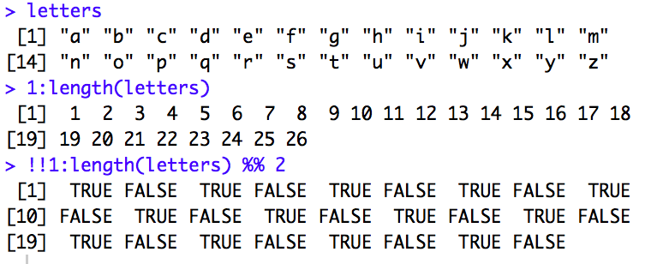
Vectors

Slide 4
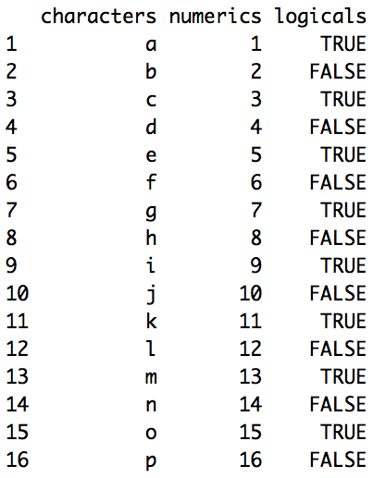
Data Frames (tables with rows and columns)

Slide 5
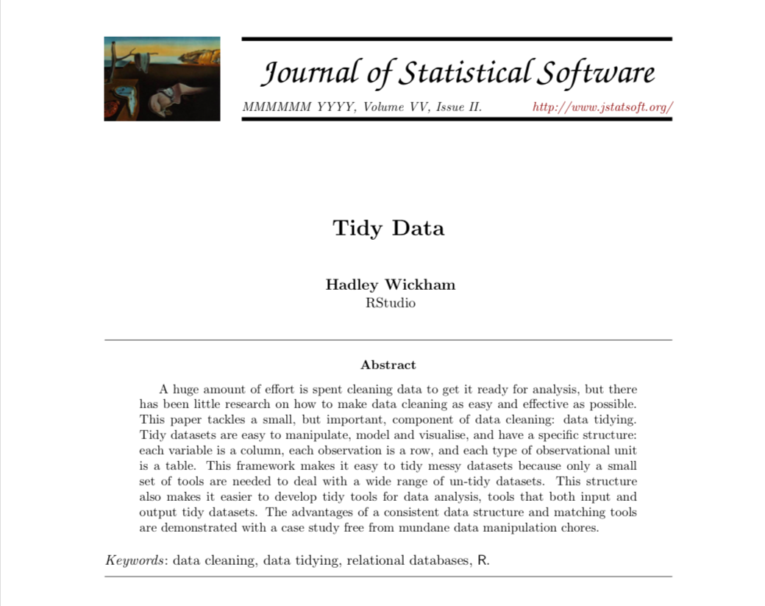
Tidy Data
Each variable forms a column
Each observation forms a row
Each type of observational unit forms a table

Slide 6
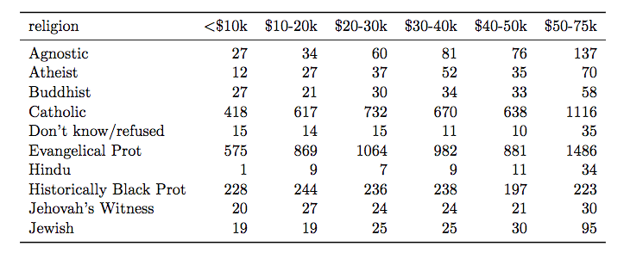
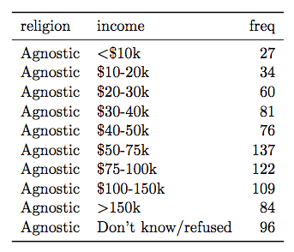
Tidy Data - Shape of Data Matters

Slide 7
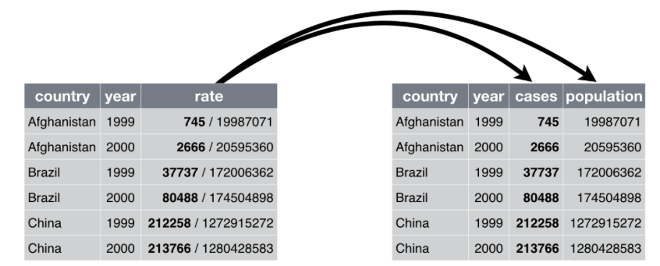
Tidy Data - Content of Cells Matter

Slide 8


Tidy Data - Tools & Resources
http://r4ds.had.co.nz
@hadleywickham

Slide 9

Goal - Format Data to Create Graphs with igraph

Slide 10
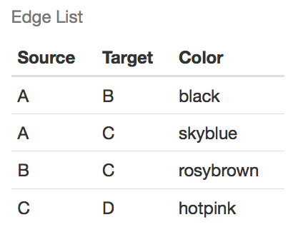
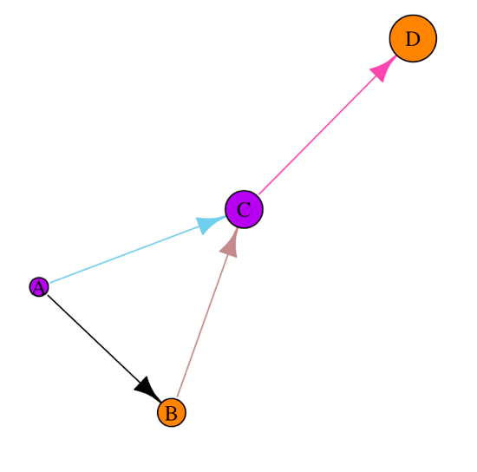
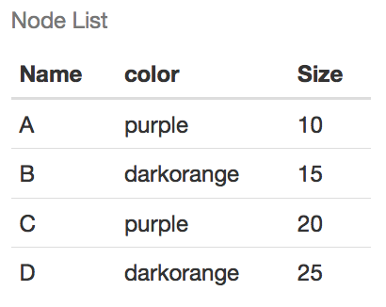
igraph::graph_from_data_frame()

Slide 11
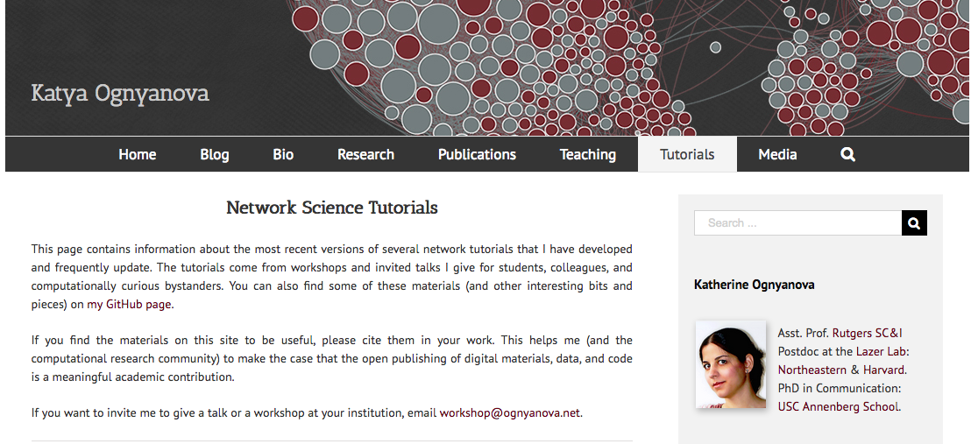
Resources For igraph
http://kateto.net/tutorials/
@Ognyanova

Slide 12
Where Can We Get Data?

Slide 13







Where Can We Get Data?

Slide 14
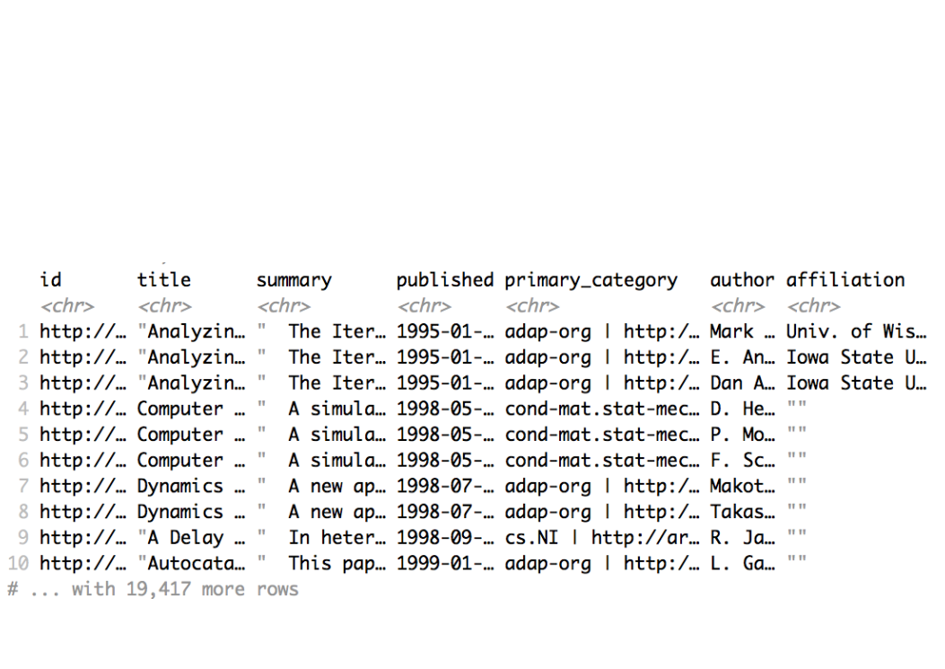
aRxiv::arxiv_search()
QUERY arXiv for: 'abs:social AND abs:network'

Slide 15
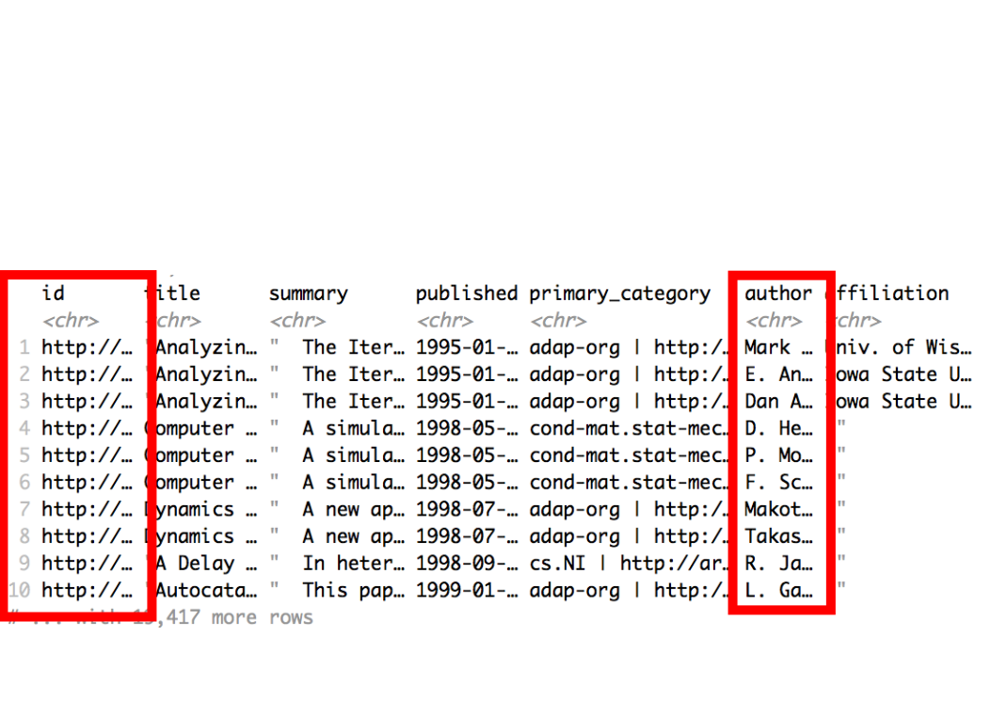
Collaboration Networks

Slide 16
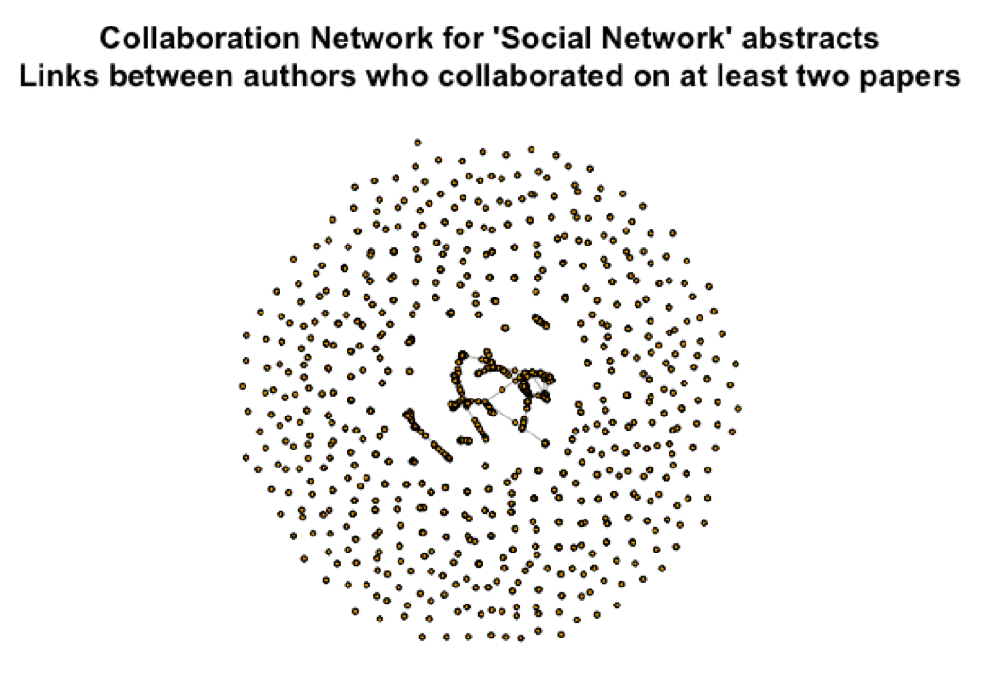
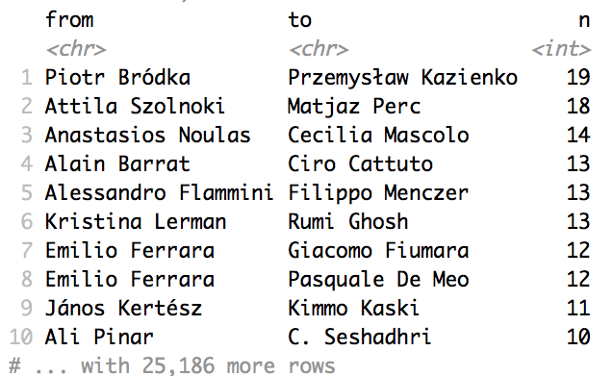
Working With Publication Data

Slide 17
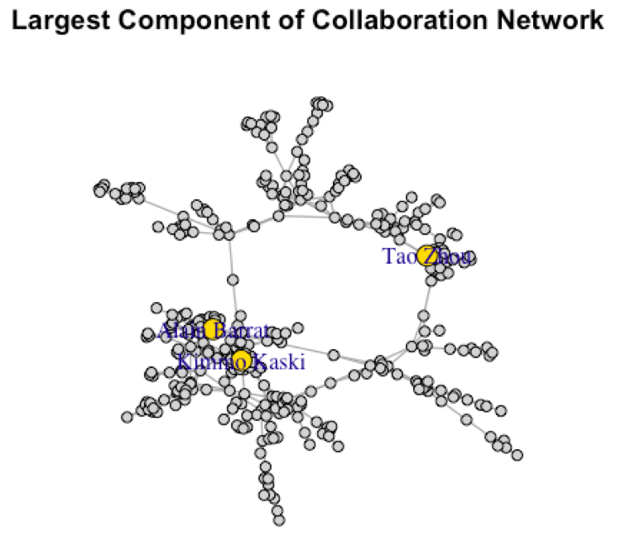

Slide 18
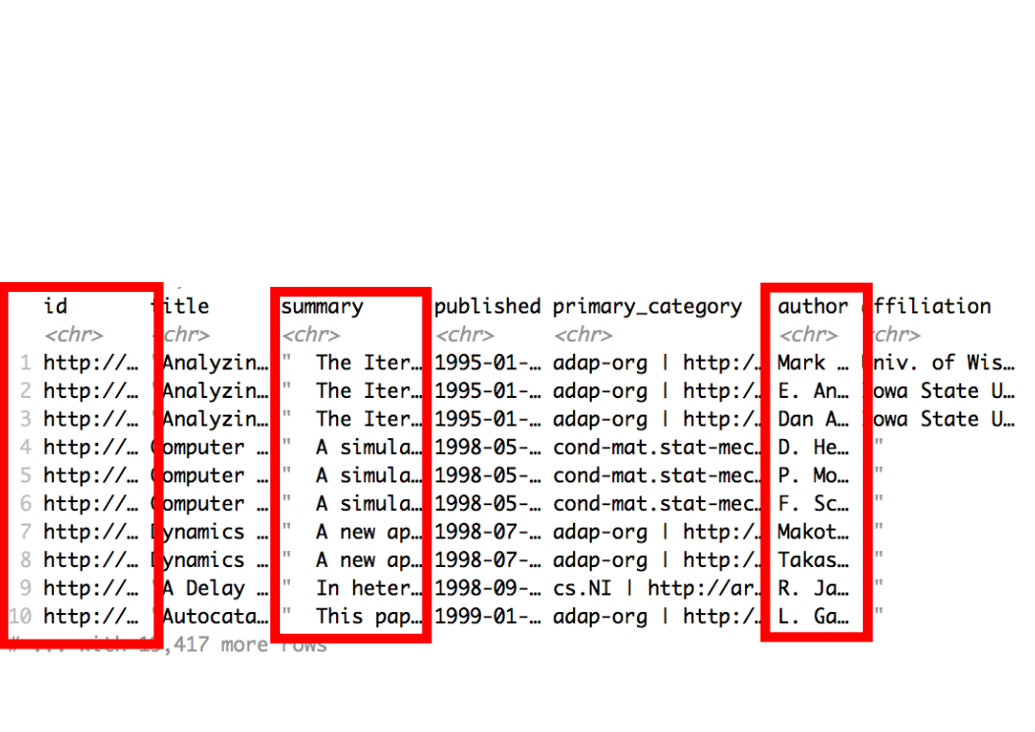
Modelling Text Data (LDA)

Slide 19
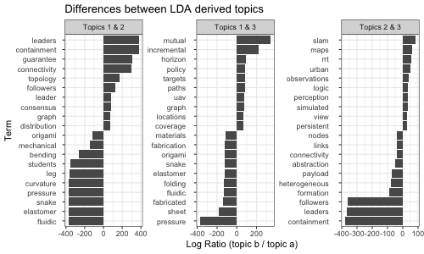
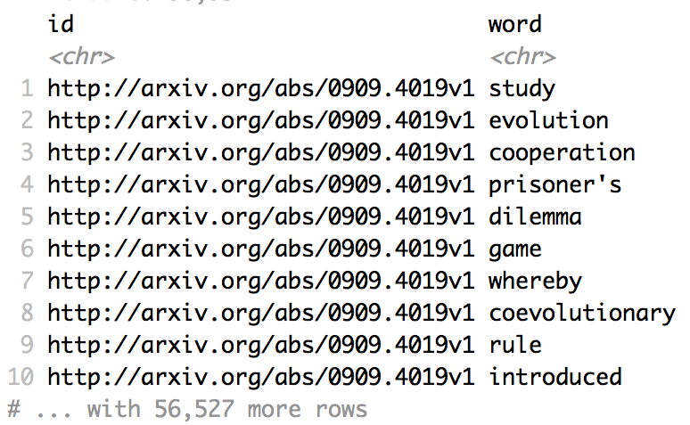
tidytext::unnest_tokens()

Slide 20
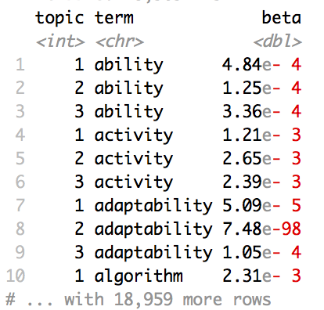
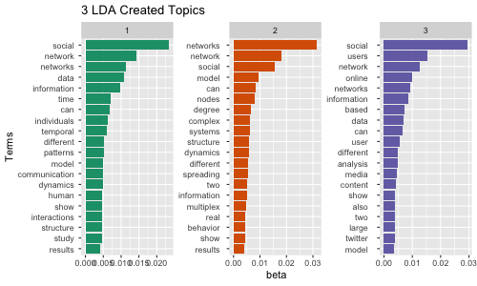
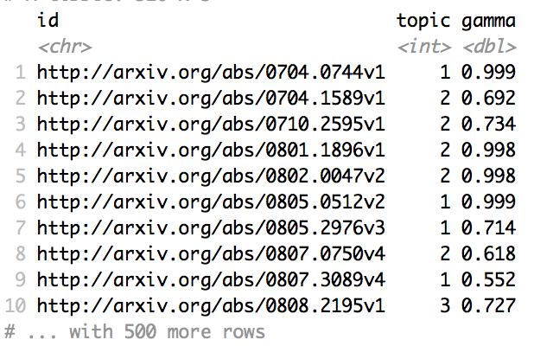
topicmodels::LDA()

Slide 21
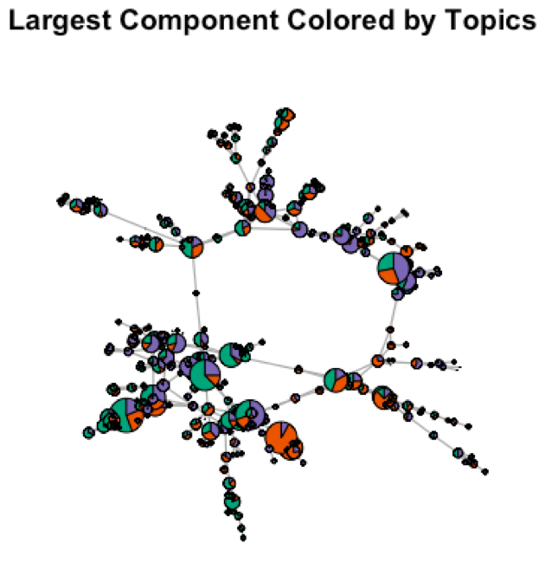
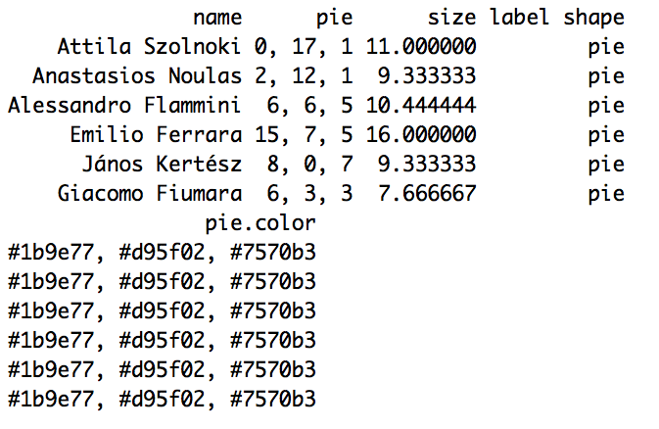
Incorporating LDA Topics to Networks

Slide 22

Resources For Text
https://www.tidytextmining.com/
@juliasilge
@drob

Slide 23
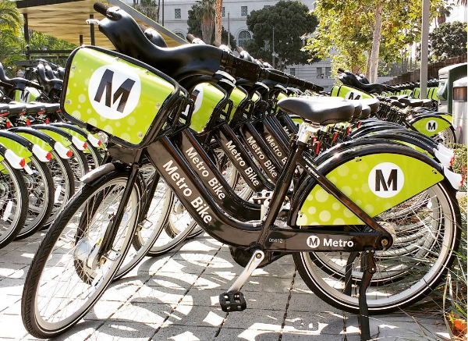
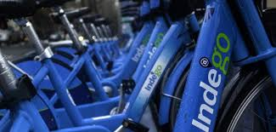
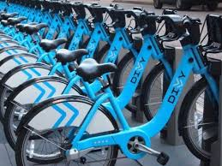
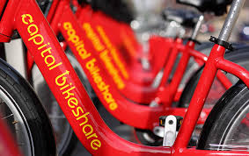
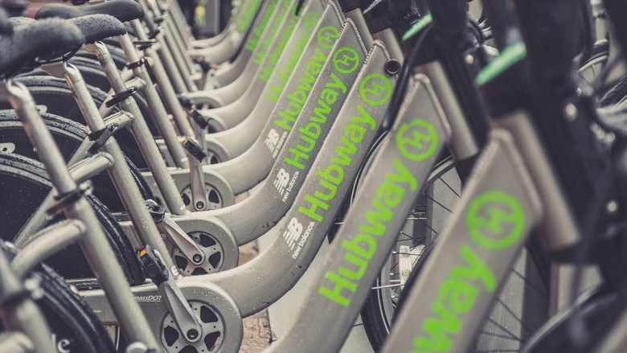
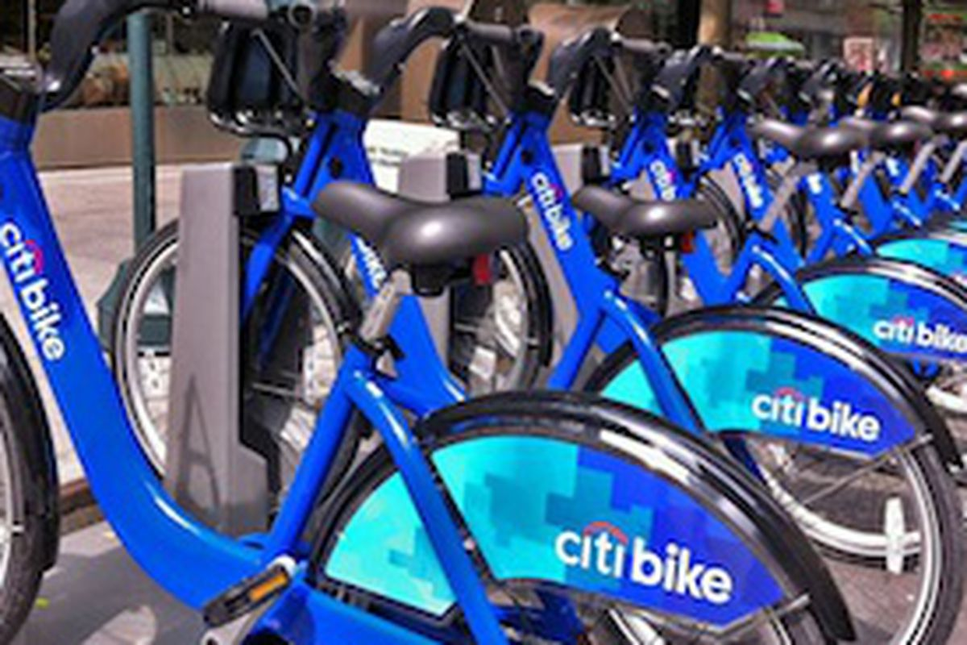
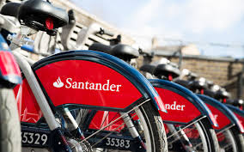
Where Can We Get Data?

Slide 24
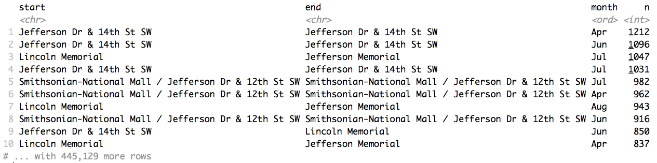
We Have Trip Information

Slide 25
Similar to Edge List

Slide 26
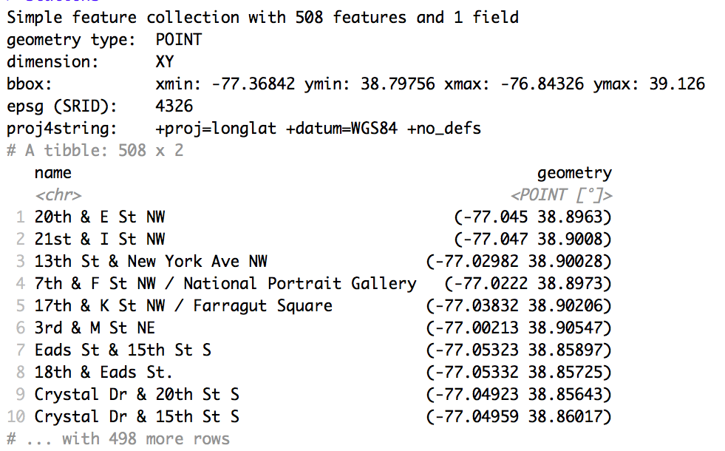
We Have Dock Station Coordinates

Slide 27
Similar to Node List

Slide 28
Coordinates are Similar to Node Attributes

Slide 29
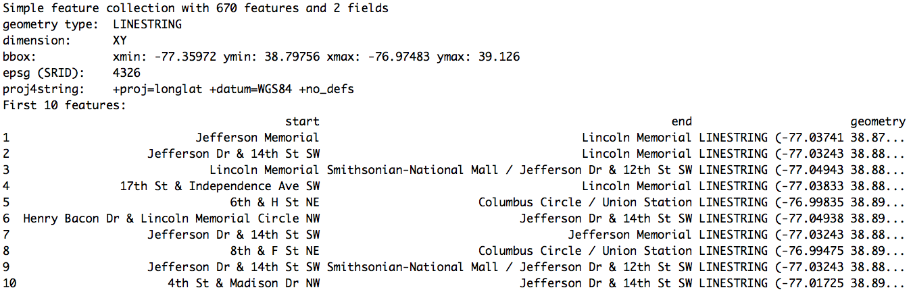
Create a Spatial Line With stplanr::od2line()

Slide 30
LINESTRING Joins Dock Station Coordinates

Slide 31
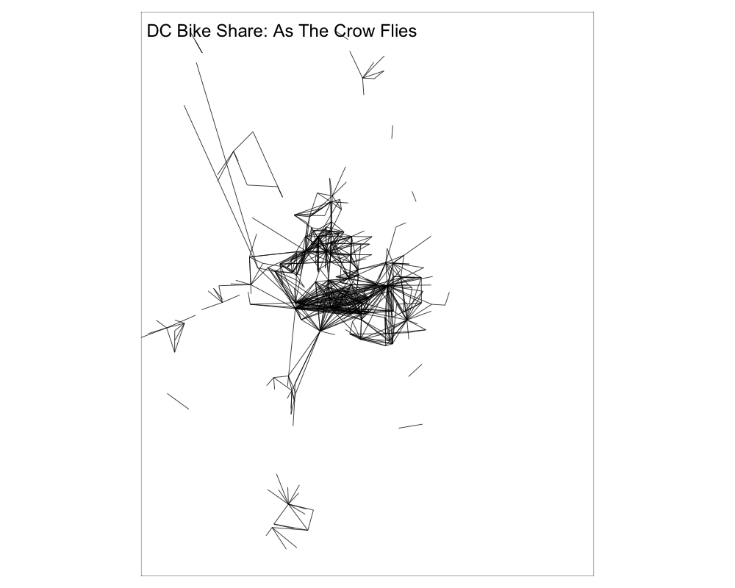

Slide 32
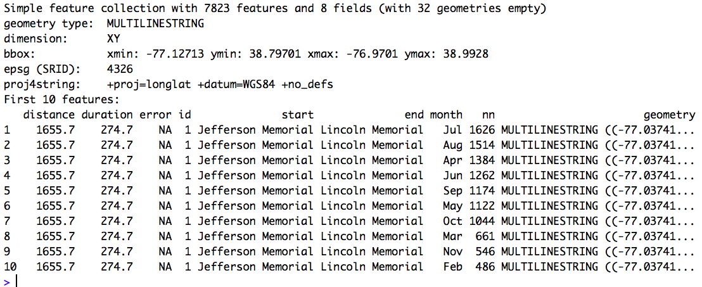
Guess Actual Routes With stplanr::line2route()

Slide 33
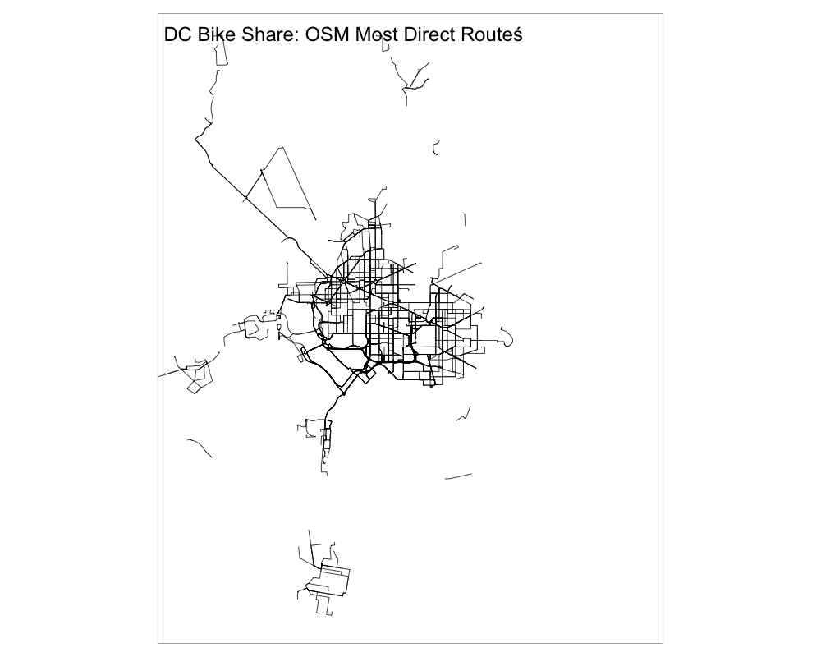

Slide 34
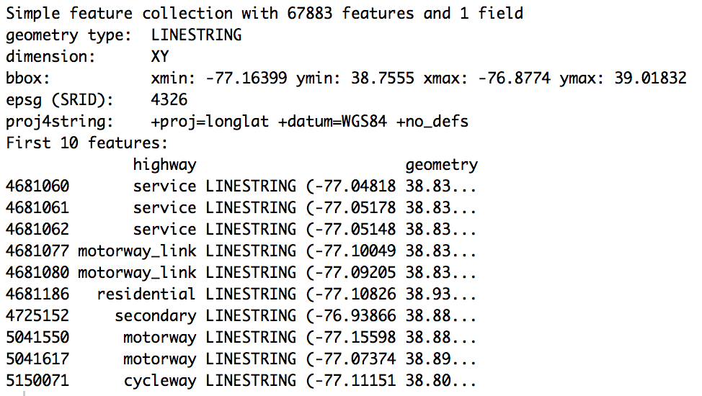
Get More Roads With osmdata::opq()

Slide 35
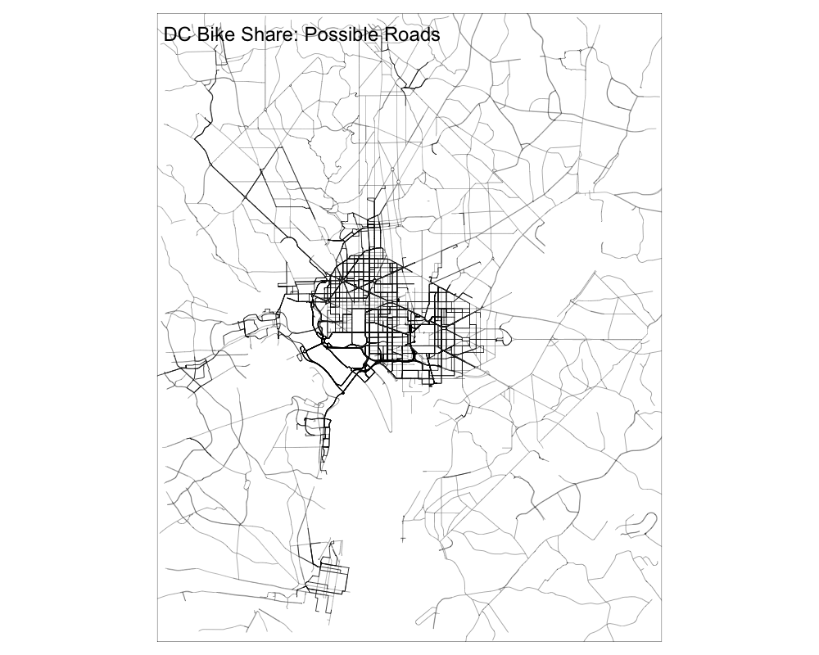

Slide 36
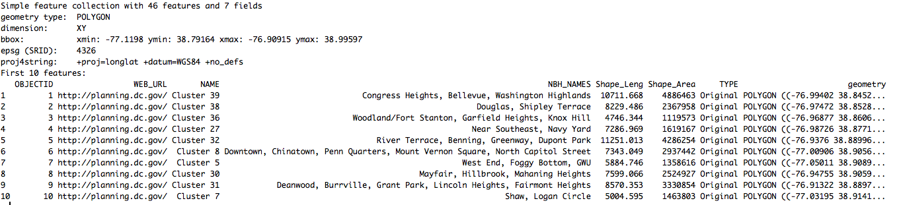
ShapeFiles Often Provide Useful Border Info

Slide 37
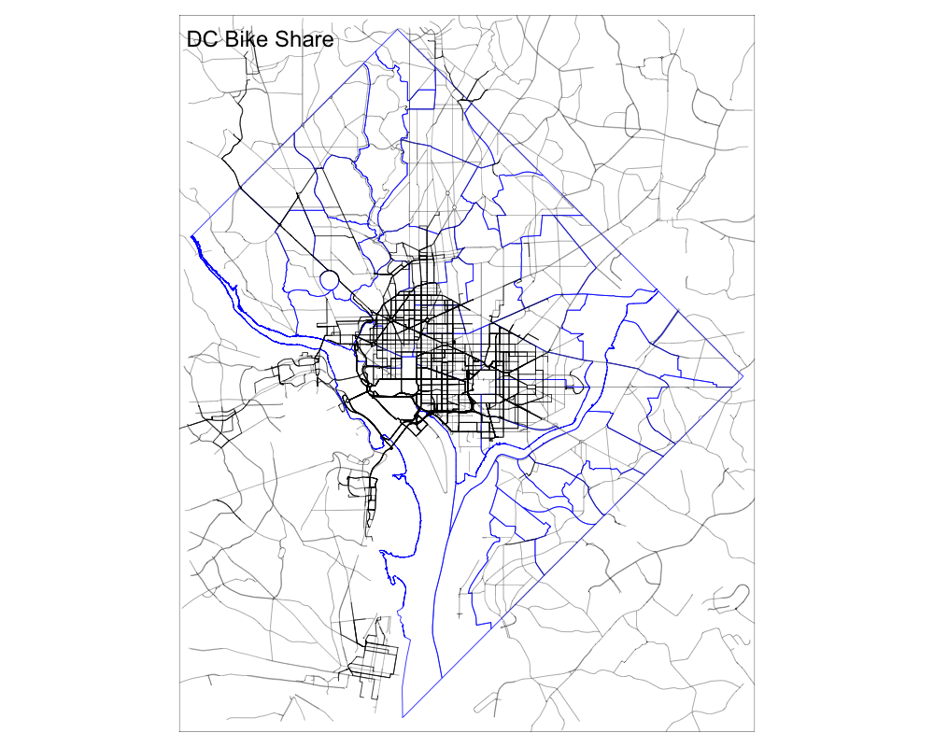

Slide 38
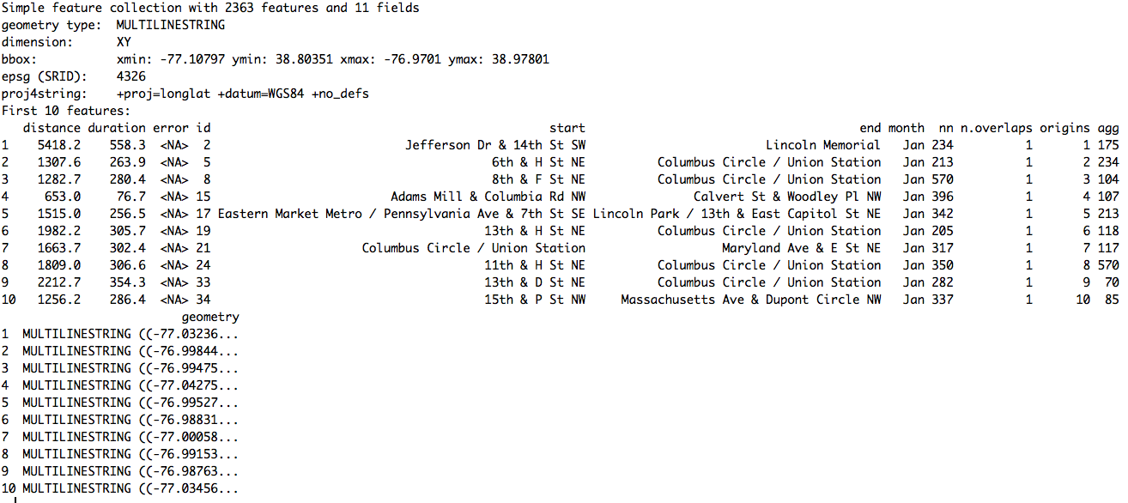
Spatial Features Can Contain Data

Slide 39
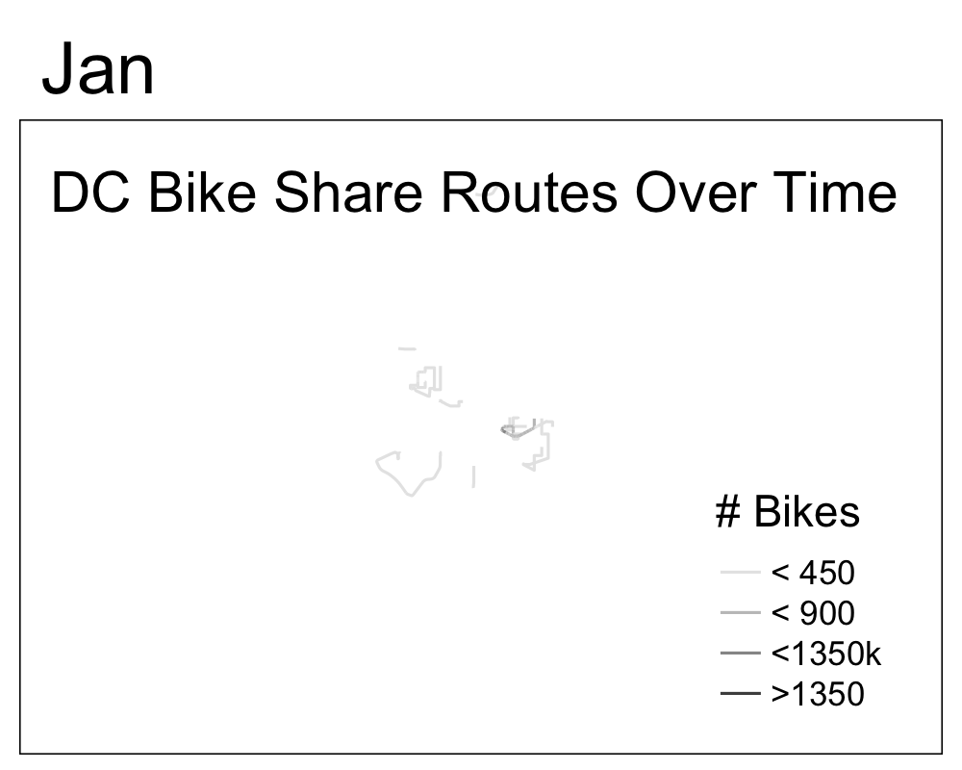

Slide 40
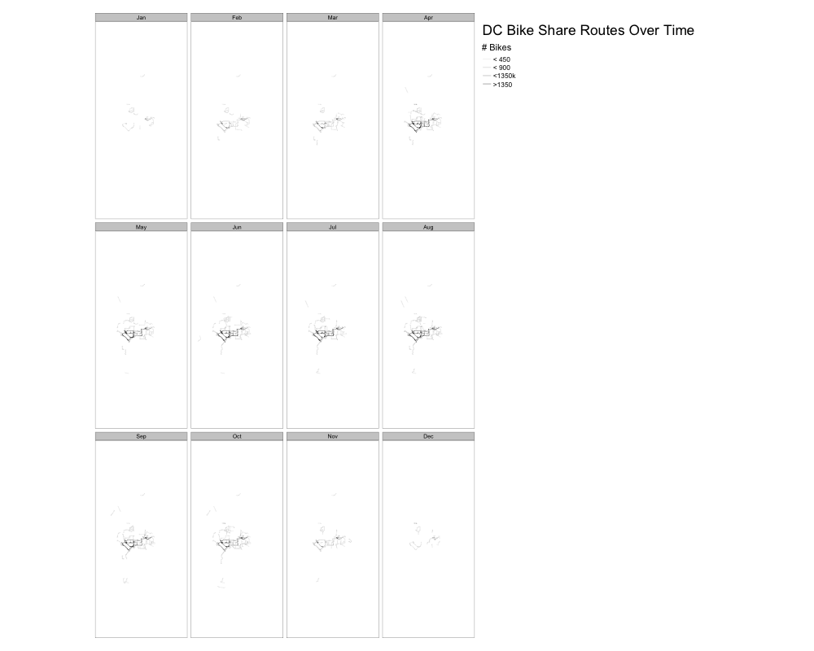

Slide 41
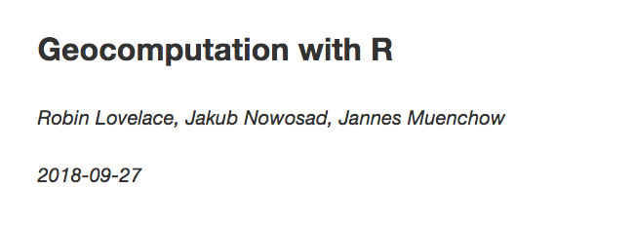
Resources
https://geocompr.robinlovelace.net/
@robinlovelace
Also check out: @bikesRdata

Slide 42
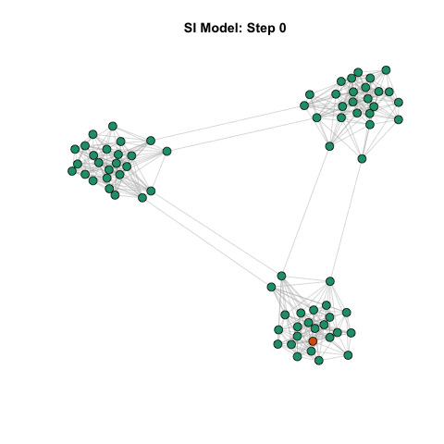
Make Your Own Data

Slide 43
Hands on Intro

